Slide 1
National Society of Black Engineers Region III
Fall First General Meeting

Slide 2
NSBE Mission Statement
To increase the number of culturally responsible Black engineers who excel academically, succeed professionally and positively impact the community

Slide 3
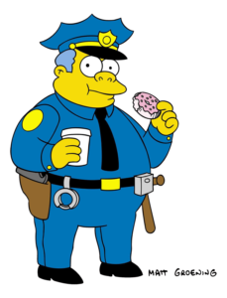
OFFICERS
Club Advisor- Professor Charles Davis
President- Luckenson Lumose
Vice President – Micheal Jaweed
Secretary- Jemima Abakah
Treasurer- Deeve Mendez
Outreach- Patrickson Lume
Project implementation- TBA
Marketing-TBA

Slide 4
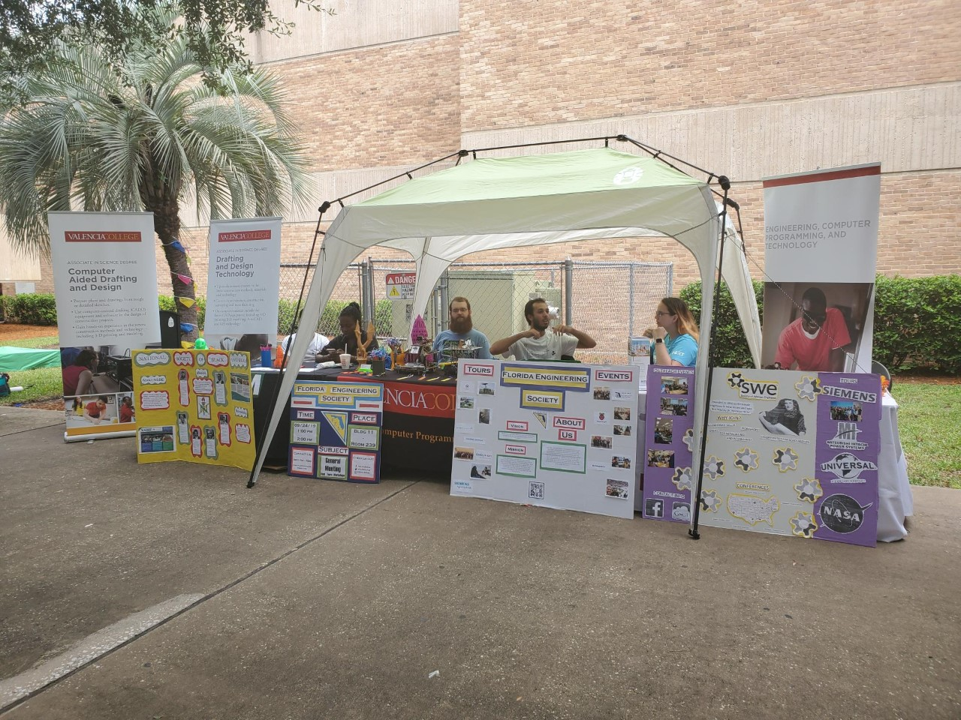
Semester Plans
Retention
Fall Regional conference
Volunteering/Events
Workshops
Guess Speaker
New ideas

Slide 5
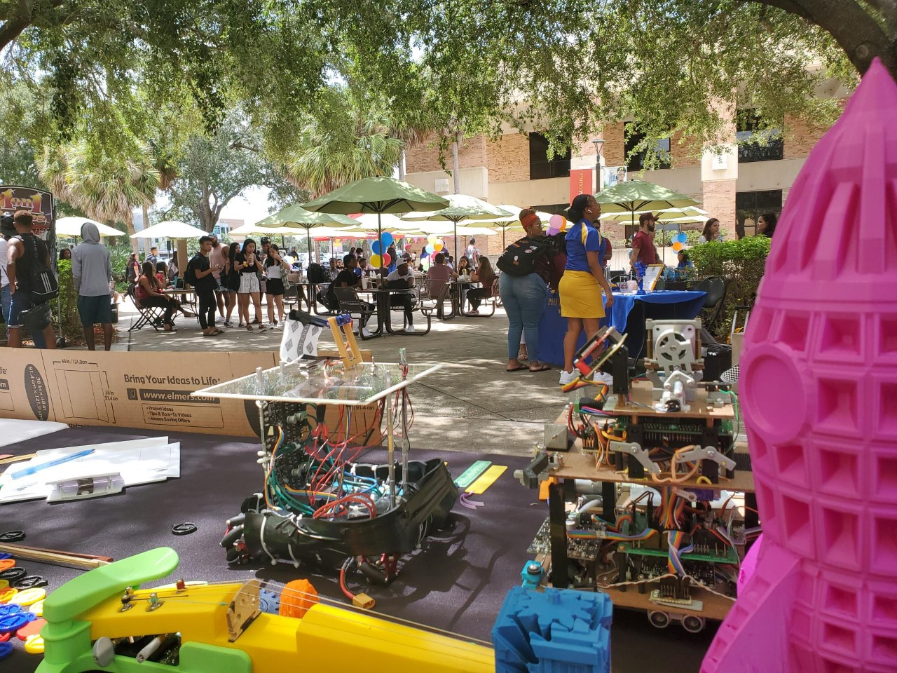
Retention
Share your ideas with us !!

Slide 6
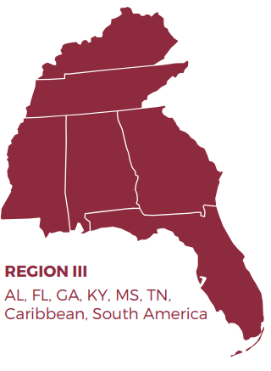
Fall Regional conference
Dates – November 15-17, 2019
Location- Tampa bay, FL
Attendees- TBA
Interview Booths
Career Fair Exhibit
Workshop
Resume Review Studio

Slide 7
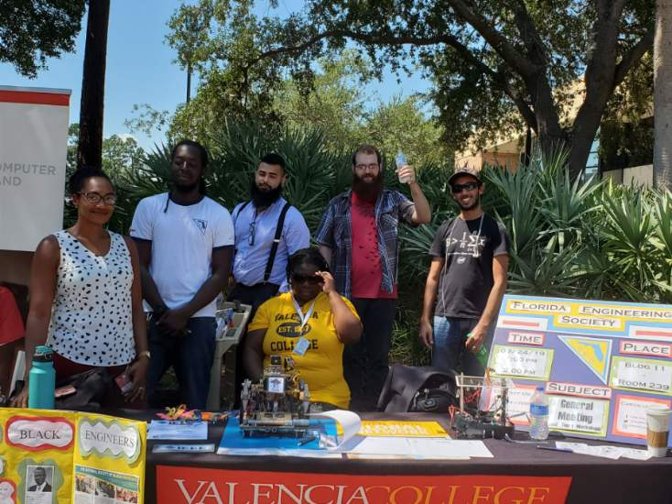
Volunteering/Events
Tabling event (Engineering week )
Walk for education
Trick-O-treat on Matador Street
Bake sale fundraiser

Slide 8
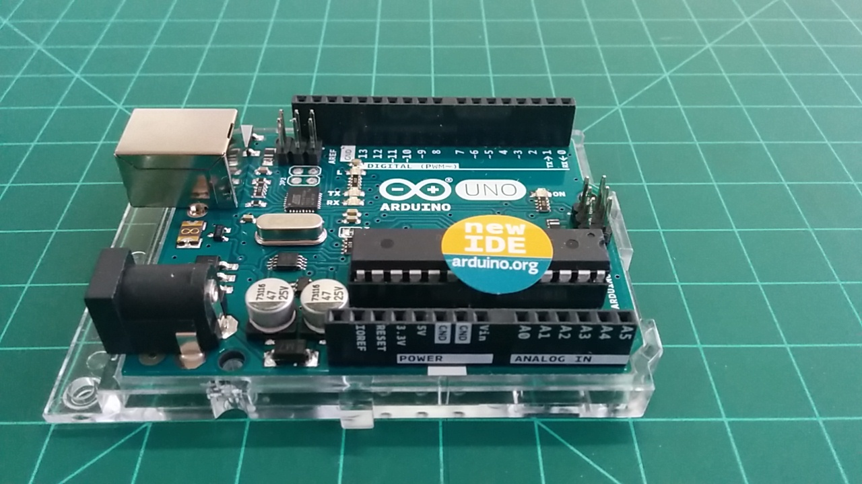
workshops
Arduino (November )
Mock interviews(November))
LinkedIn class (October)

Slide 9
Guest speaker
Nino O’Roger (Lockheed Martin System Engineer)
Valencia Alumni
FES &NSBE former member

Slide 10
A walk for education (awfe)
The goal of A Walk for Education (AWFE) is “to increase awareness of the opportunities available through education particularly in the STEM fields and to shatter myths about African-Americans in math, science, engineering and other technologies
Date-(UCF collaboration or Spring2020)

Slide 11
Trick-O-treat on Matador Street
Date: 31st of October
Time: 6:00pm – 8:00 pm
Theme 80s Stranger Things

Slide 12
NSBe future
Upcoming Meetings (October 8, 2019)
Workshop- Arduino (November)
Officer positions open. Let us know if you’re interested.
46th Annual Conference (March 25-29, 2020) Save the Date

Slide 13
Get in contact with us
Facebook: NSBE Valencia College Student Chapter
Website: http://nsbevalencia.weebly.com/
Email: nsbe.valenciacollege@gmail.com
Instagram: NSBE_VC
Become a member on engage

